Slide 1
Representing Graphs: Adjacency Lists and Matrices
CS 236
Fall 2022

Slide 2

Representing Graphs
Picture, List, Matrix

Slide 3
Graph Representations
Picture: We can draw graphs, but how do we store the information in a computer?

Slide 4
Graph Representations
Picture: We can draw graphs, but how do we store the information in a computer?
We can use adjacency lists and adjacency matrices

Slide 5
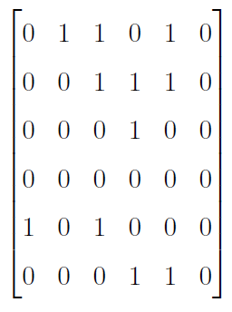
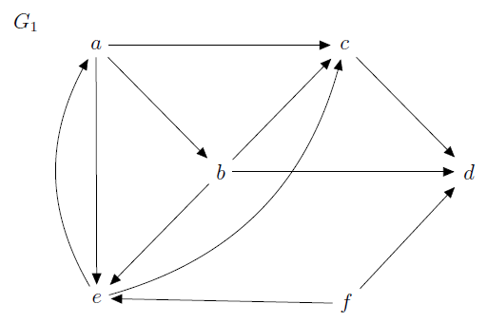
Adjacency Matrix: Directed Graph
u
v
to vertex v
from vertex u
Notes:
We’ve been doing this one with relations

Slide 6
Adjacency Matrix: Directed Graph
u
v
to vertex v
from vertex u
We’ve already used adjacency matrices with relations.
We labeled the adjacency matrix M_{R}

Slide 7
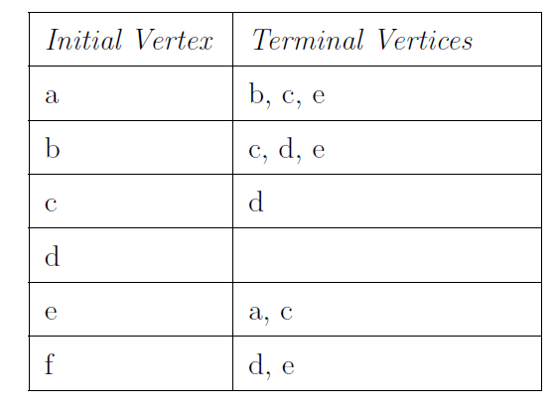
Adjacency List: Directed Graph
Graph, List, Matrix
u
v

Slide 8
Directed Graph: List, Matrix
Graph, List, Matrix

Slide 9
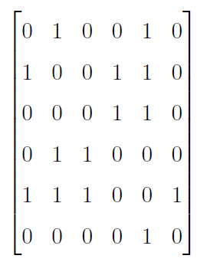
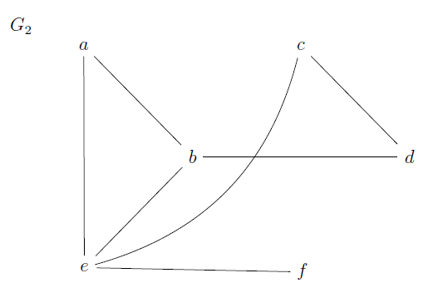
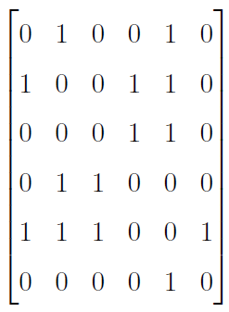
Graph Undirected: List, Matrix
Graph, List, Matrix
Symmetric Adjacency Matrix

Slide 10
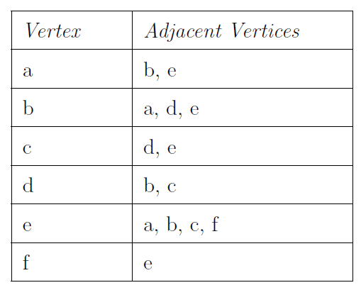
Undirected Graph: List, Matrix
Graph, List, Matrix
Note header change from
initial vertex/terminating vertices

Slide 11
Graph Undirected: List, Matrix
Graph, List, Matrix

Slide 12
Weighted Graph: Picture, List, Matrix
Graph, List, Matrix
Think of edge weights as things like
distances
times
strength of friendships
probabilities of meeting
1
6
3
5
4
2
7

Slide 13
Weighted Graph: Picture, List, Matrix
Graph, List, Matrix
Instead of just 1’s and 0’s,
use edge weights in matrix
1
6
3
5
4
2
7
Notes:
\left[\begin{array}{cccccc}
0 & 1 & 0 & 0 & 3 & 0 \\
1 & 0 & 0 & 5 & 4 & 0 \\
0 & 0 & 0 & 6 & 2 & 0 \\
0 & 5 & 6 & 0 & 0 & 0 \\
3 & 4 & 2 & 0 & 0 & 7 \\
0 & 0 & 0 & 0 & 7 & 0
\end{array}\right]

Slide 14
Weighted Graph: Picture, List, Matrix
Graph, List, Matrix
Put the edge weight next to
the terminating vertex
1
6
3
5
4
2
7
Notes:
\left[\begin{array}{cccccc}
0 & 1 & 0 & 0 & 3 & 0 \\
1 & 0 & 0 & 5 & 4 & 0 \\
0 & 0 & 0 & 6 & 2 & 0 \\
0 & 5 & 6 & 0 & 0 & 0 \\
3 & 4 & 2 & 0 & 0 & 7 \\
0 & 0 & 0 & 0 & 7 & 0
\end{array}\right]
\begin{array}{|l|l|} \hline
\mbox{Vertex} & \mbox{Adjacent vertices, weight} \\\hline
a & (b,1),\ (e,3)\\\hline
b & (a,1),\ (d,5),\ (e,4)\\\hline
c & (d,6),\ (e,2)\\\hline
d & (b,5),\ (c,6)\\\hline
e & (a,3),\ (b,4),\ (c,2),\ (f,7)\\\hline
f & (e,7)\\\hline
\end{array}

Slide 15
Graph Representations
Memory Considerations
It is more efficient to store a graph as an adjacency list when it is sparse, that is when there are few edges (think more 0’s than 1’s in the matrix)
It is more efficient to store a graph as an adjacency matrix when it is dense, that is when there are many edges (think more 1’s than 0’s in the matrix)

Slide 16
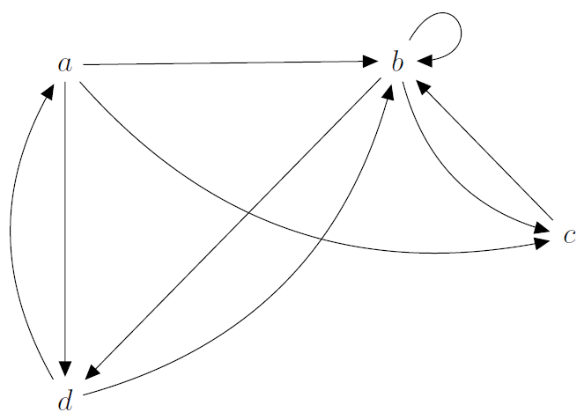
Graph Adjacency: Exercise
Create the corresponding adjacency list and matrix for the graph

Slide 17
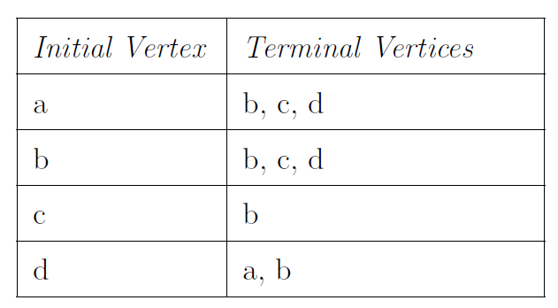
Graph Adjacency: Exercise
Create the corresponding adjacency list and matrix for the graph

Slide 18
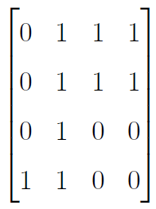
Graph Adjacency: Exercise
Create the corresponding adjacency list and matrix for the graph

Slide 19
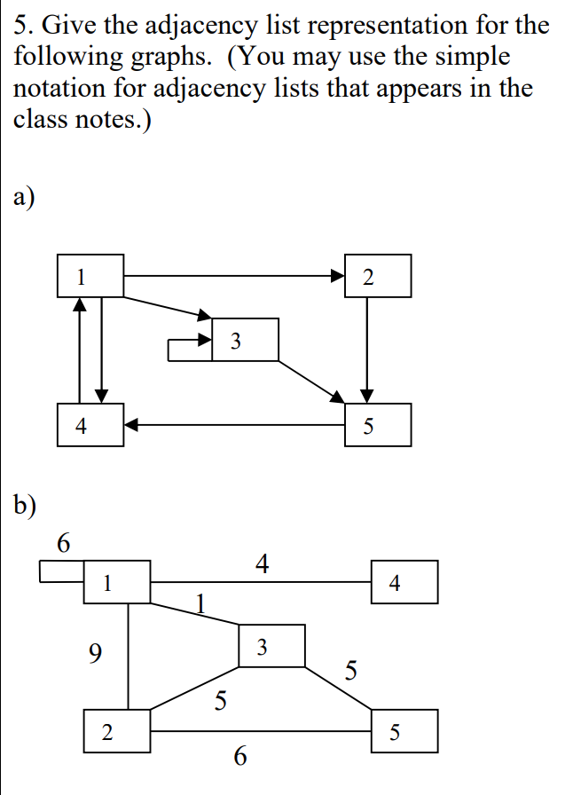
Tree Traversal

Slide 20

Tree Traversal
A review

Slide 21
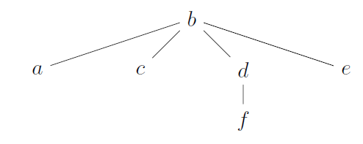
Depth-First Search on a Tree – 235 Review
Depth first search visits to the deepest depth of leftmost branch before moving left to right
Start here
Stack
b

Slide 22
Depth-First Search on a Tree – 235 Review
Depth first search visits to the deepest depth of leftmost branch before moving left to right
Pop b and add its children
Stack
e
d
c
a

Slide 23
Depth-First Search on a Tree – 235 Review
Depth first search visits to the deepest depth of leftmost branch before moving left to right
Pop a and add its children
Stack
e
d
c

Slide 24
Depth-First Search on a Tree – 235 Review
Depth first search visits to the deepest depth of leftmost branch before moving left to right
Pop c and add its children
Stack
e
d

Slide 25
Adjacency List for Tree
Notice that I added edge directions
Parent-child relationship
Note also that I’ve added a “visited”
column. This will help us when we
do a depth first search on a graph

Slide 26
Adjacency List for Tree
Let’s say that a vertex
is visited when it is
popped off the stack
Stack
b
We’ll look at other
rules for when a vertex
is visited on Monday

Slide 27
Adjacency List for Tree
Let’s say that a vertex
is visited when it is
popped off the stack
Stack
b

Slide 28
Adjacency List for Tree
Let’s say that a vertex
is visited when it is
popped off the stack
Stack
e
d
c
a
✔️

Slide 29
Adjacency List for Tree
Let’s say that a vertex
is visited when it is
popped off the stack
Stack
e
d
c
✔️
✔️

Slide 30
Adjacency List for Tree
Let’s say that a vertex
is visited when it is
popped off the stack
Stack
e
d
✔️
✔️
✔️

Slide 31
Adjacency List for Tree
Let’s say that a vertex
is visited when it is
popped off the stack
Stack
e
f
✔️
✔️
✔️
✔️

Slide 32
Adjacency List for Tree
Let’s say that a vertex
is visited when it is
popped off the stack
Stack
e
✔️
✔️
✔️
✔️
✔️

Slide 33
Adjacency List for Tree
Let’s say that a vertex
is visited when it is
popped off the stack
Stack
✔️
✔️
✔️
✔️
✔️
✔️

Slide 34
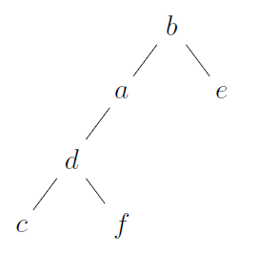
Depth-First Search on a Tree – 235 Review
Visit order: two different trees
Leftmost
branch

Slide 35
Depth-First Search on a Tree – 235 Review
Visit order
Leftmost branch
Moving left to right

Slide 36
Depth-First Search on a Tree – 235 Review
Visit order
Step 1
Step 2
Step 3

Slide 37
Depth-First Search on a Tree – 235 Review
Visit order
Step 1
Step 2
Step 3
Step 4

Slide 38
Stack versus Queue – An aside
Using a stack gives a depth-first-search traversal of a tree
Using a queue gives a breadth-first-search traversal of a tree

